Slide 1
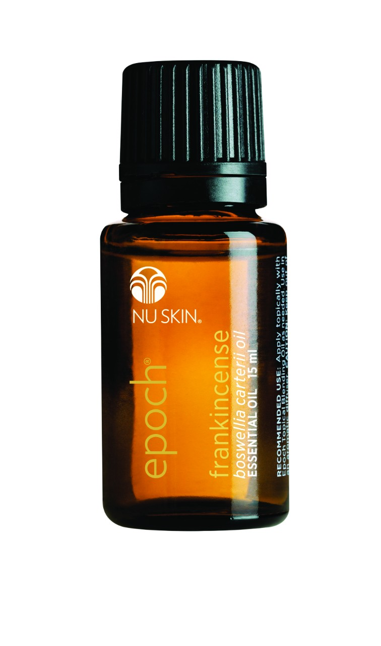
EPOCH
FRANKINCENSE
ESSENTIAL OIL

Slide 2
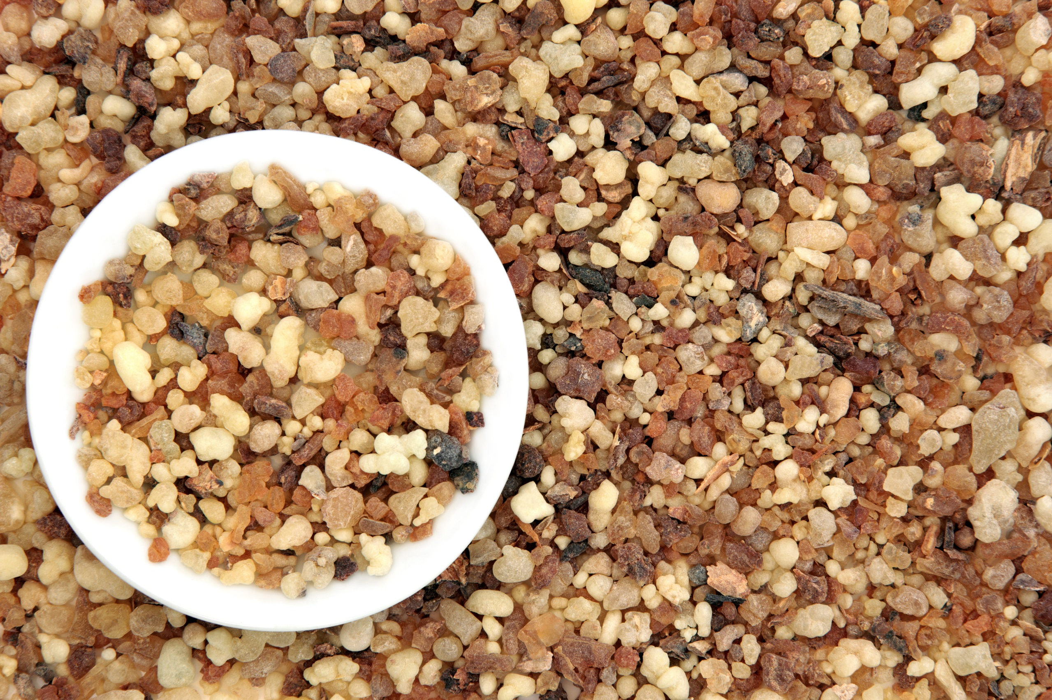
FRANKINCENSE
The aromatic profile of Epoch Frankincense is rich, woody, and warm

Slide 3
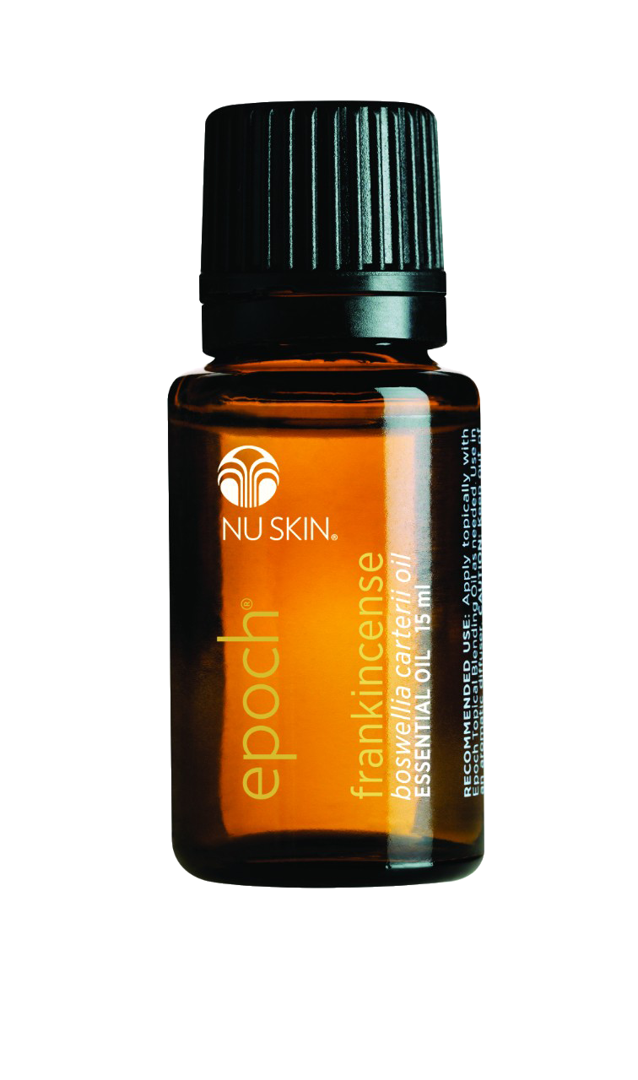
USAGE
Diffuse with an Epoch diffuser
Dilute and rub on hands
Apply directly to soles of feet
Apply to skin after showering
Dilute and massage on arms or legs
Mix with Epoch Topical Blending Oil
and apply to face

Slide 4
EPOCH FRANKINCENSE
PEACE | CONNECTEDNESS | PURPOSE | SATISFACTION

