Slide 1
Science presentation

Slide 2
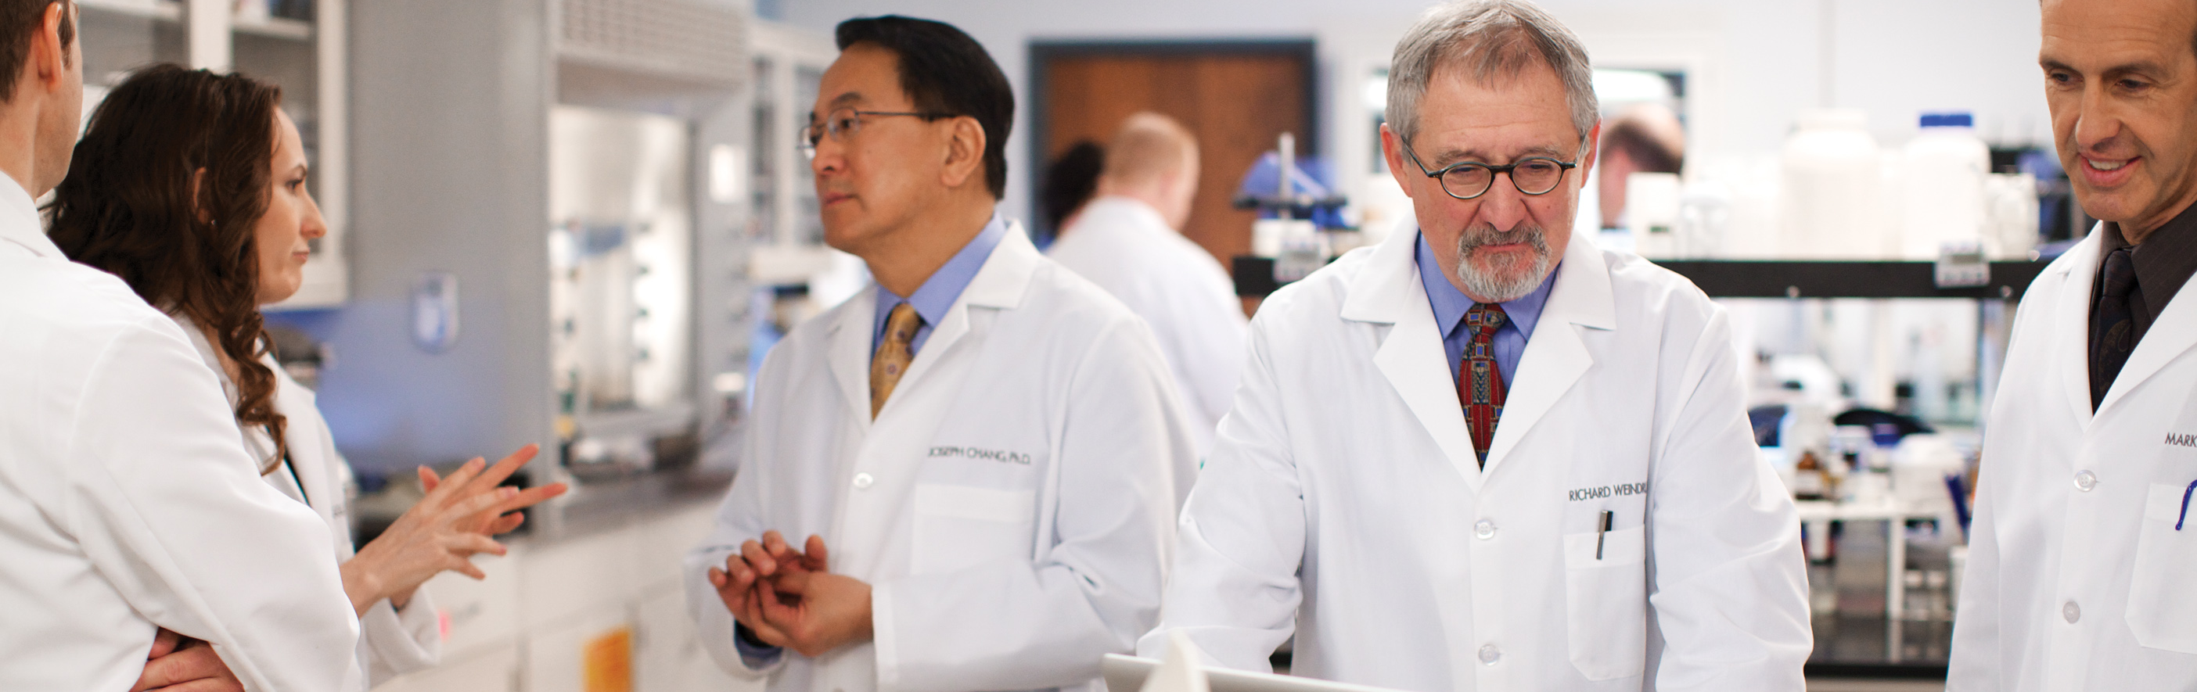
our world-class SCIENCE
• Proprietary science with more than 30 years of anti-aging research
• Large team of expert in-house scientists
• Collaborations with leading research institutions
• Specialties in skin care and nutritional product science with extensive product portfolios in each
• Focus on targeting sources—not just the symptoms—of aging
Notes:
Our proprietary Nu Skin science and more than 30 years of anti-aging research allow us to continue to understand the science of aging and to develop innovative, high-quality anti-aging products.
Nu Skin has a team of expert, highly skilled in-house scientists.
We also demonstrate our commitment to research and development by collaborating with multiple leading research institutions. These collaborative relationships help us develop an enhanced understanding of what happens when we age and discover ways to fight the signs of aging.
With our extensive product portfolios in anti-aging skin care and nutritional supplements, we’re able to promote both a youthful look and feel.
Our advanced understanding of gene expression allows us to develop products that target the sources—not just the symptoms—of aging.

Slide 3

Our innovation through 2015
Notes:
Part of how we’re innovative is we continue to learn and to deepen our understanding of the aging process so we can develop new ways to help people look and live younger. In the following slides, we’ll discover how Nu Skin’s continued study of how and why we age has helped us create high-quality, innovative products.

Slide 4
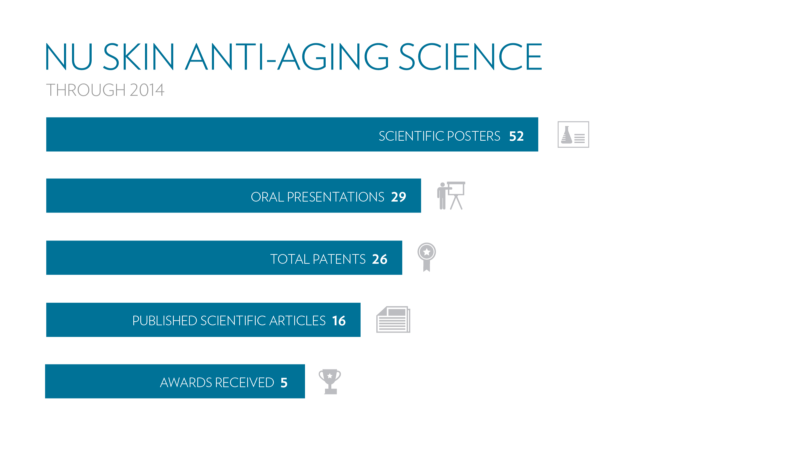
Notes:
We’ve published 52 scientific posters based on studies we have conducted.
We’ve also given 29 presentations about our discoveries at conferences around the world.
We now have 26 patents or patents pending on our proprietary Nu Skin science and products.
We’ve published and presented our findings and discoveries to the scientific community with 16 articles.
We’ve also received four prestigious awards for our innovative science.

Slide 5
NU SKIN® APPROACH TO ANTI-AGING SCIENCE
Aging Signs
And Symptoms
Treat signs and symptoms
Identify and address the sources of aging
Aging Sources
TRADITIONAL APPROACH
TO ANTI-AGING
SCIENCE
NU SKIN’S
APPROACH
TO ANTI-AGING
SCIENCE
Notes:
Our proprietary anti-aging science focuses on studying the aging process at the genetic level. This deeper understanding allows us to identify and address the sources of aging. With this knowledge, we’re able to develop products that target the actual sources—and don’t just treat the signs and symptoms—of aging.

Slide 6
targeting the sources of aging
A HISTORY OF INNOVATION
2008: Focused on arNOX suppression
Notes:
At Nu Skin, we have a history of innovation. Our primary focus, targeting the sources of aging, is a key differentiator for us and the foundation of our scientific approach. Let’s travel back in time for a moment and learn how Nu Skin’s early research into the genetic basis of aging has gotten us to where we are today. In 2008, we began to focus on arNOX suppression.

Slide 7
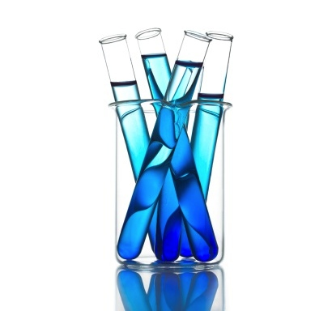
ARNOX SUPPRESSION
Free radicals are unstable molecules that can cause skin aging. We’re exposed to them through pollution, UV radiation, stress, and many other factors. We also produce them naturally inside our bodies.
Many of the free radicals inside our bodies are produced through an enzyme called Age-Related NADH Oxidase (arNOX).
In 2008, Nu Skin began developing formulations to suppress arNOX and its production of free radicals.
Notes:
To understand arNOX and how it contributes to aging, it’s important to understand the role of free radicals. Free radicals are unstable molecules that can cause skin aging. We’re exposed to them through pollution, UV radiation, stress, and many other factors. We also produce them naturally inside our bodies.
Many of the free radicals inside our bodies are produced through an enzyme called Age-Related NADH Oxidase (arNOX).
In 2008, Nu Skin began developing formulations to suppress arNOX and its production of free radicals. This began our journey to discover and target the internal sources of aging—to fight aging from within.

Slide 8
A HISTORY OF INNOVATION
targeting the sources of aging
2009: Identified Facial Skin YGCs
2008: Focused on arNOX suppression
Notes:
In 2009, we began to delve into the study of the genetic basis of aging. We knew that the best way to fight aging would be to target the sources—the genes within us—that cause aging. And that year, we identified Youth Gene Clusters (YGCs), or key groups of genes that contribute to aging. That was a true breakthrough for us. Once we identified which genes contributed to aging, we could develop products to influence the way these genes expressed themselves to promote a more youthful appearance.

Slide 9
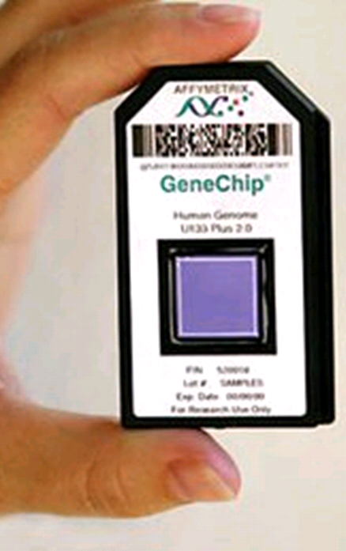

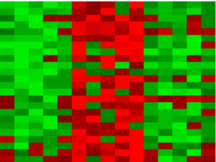
our unique Understanding of gene expression
1. The breakthrough mapping of the Human Genome allows scientists to look at an entire set of genes within the DNA.
2. Nu Skin’s proprietary understanding allows us to focus on specific sets of genes to interpret and understand their expression.
DNA Microarray Gene Map
Over 20,000 Genes
Heatmap
Notes:
The Human Genome project, which completed in 2003, allows scientists to look at the 20,000 plus genes within our DNA. With our extensive study and understanding of the human genome (or, DNA Microarray Gene Map) we’ve been able to focus on the Youth Gene Clusters that influence aging to interpret and further understand their expression. Because we have identified these key sets of genes that contribute to aging, we can monitor their activity and expression over time to determine how best to influence their expression to promote a more youthful look and feel.

Slide 10
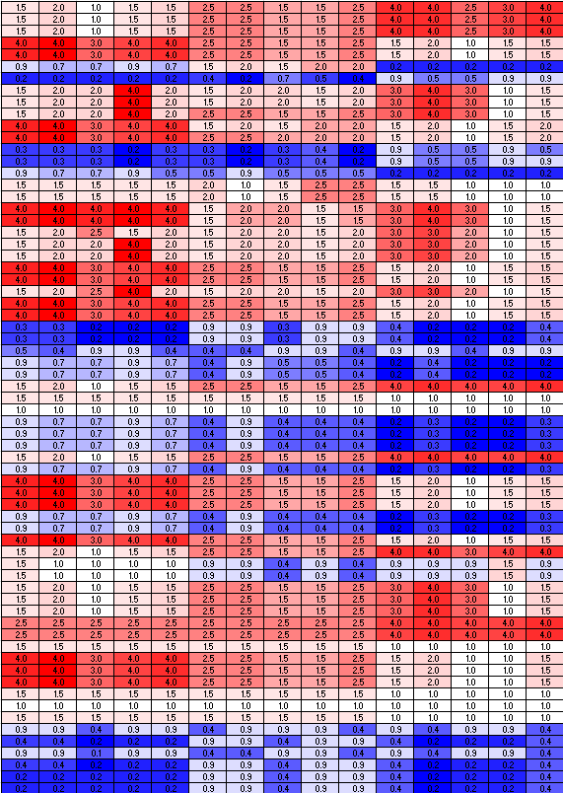
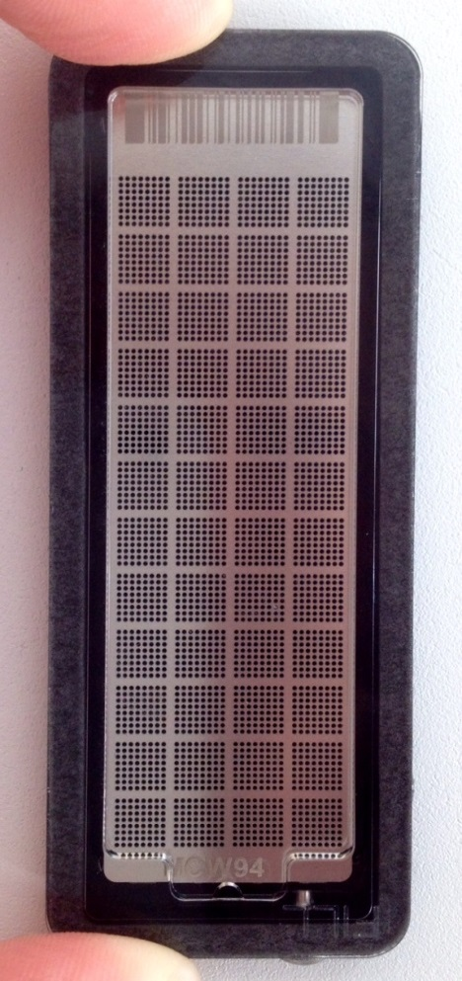
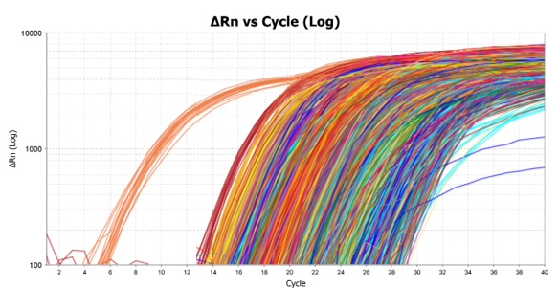
we monitor gene
expression over time
The PCR plate allows scientists to monitor how genes react over time, giving a clearer and better understanding of gene expression overall.
PCR Plate
PCR Amplification Graph
PCR Data
Notes:
A PCR plate allows us to monitor gene expression over time to test our key product ingredients for their effect on YGCs. From the plate, we’re able to compile information into a graph that we then put into a PCR data chart. From the chart, we create our heatmaps.

Slide 11
We illustrate results
Notes:
Our heatmaps illustrate clinical study results of certain ingredients. Some genes we upregulated and some we downregulated to promote more youthful gene expression.

Slide 12
IDENTIFIED FACIAL SKIN YGCS
Lines & Wrinkles
Skin Structure
Skin Structure
Discoloration
Pigmentation
ANTI-AGING SCIENCE
Uneven Skin Tone
Hydration
Hydration
Smoothness, Texture
Cell Turnover
Radiance
Pore Size
Notes:
The specific YGCs we targeted in 2009 influenced skin structure, pigmentation, hydration, and cell turnover. We were able to influence these genes to express themselves more youthfully to produce a younger appearance by helping improve lines and wrinkles, skin structure, discoloration, uneven skin tone, hydration, skin texture, radiance, and pore size.

Slide 13
A HISTORY OF INNOVATION
targeting the sources of aging
2011: Identified Body Skin YGCs
2009: Identified Facial Skin YGCs
2008: Focused on arNOX suppression
Notes:
In 2011, we applied a similar method to identify Youth Gene Clusters that influence the aging process of skin on the body.

Slide 14
IDENTIFIED BODY SKIN YGCS
BODY YOUTH GENE CLUSTER
Targets genes responsible for:
MOVEMENT
OF FLUID
LOOK YOUNG
ANTI-AGING
SCIENCE
SKIN
STRUCTURE
Decreased Appearance of Cellulite
Firming
Lifting
Smoothing
Hydrating
HYDRATION
LIPID METABOLISM
Appearance of cellulite = Depth extent, surface texture.
Notes:
These YGCs are responsible for the movement of fluid throughout the body, skin structure, hydration, and lipid metabolism within the body. By understanding the behavior of these YGCs, we have an increased understanding of how to influence their expression to help firm, lift, smooth, and hydrate the skin, as well as decrease the appearance of cellulite.

Slide 15
A HISTORY OF INNOVATION
targeting the sources of aging
2012: Expanded Facial Skin YGCs
to include firming
2011: Identified Body Skin YGCs
2009: Identified Facial Skin YGCs
2008: Focused on arNOX suppression
Notes:
Just one year later, in 2012, we identified Youth Gene Clusters that contribute to the loss of firmness in facial skin.

Slide 16
EXPANDED FACIAL SKIN YGCS
TO INCLUDE FIRMING
Lines & Wrinkles
Skin Structure
Skin Structure
& Firming
Firming
Discoloration
Pigmentation
ANTI-AGING SCIENCE
Uneven Skin Tone
Hydration
Hydration
Smoothness, Texture
Cell Turnover
Radiance
Pore Size
Notes:
As a result, were were able to influence these YGCs to promote a firmer, more contoured appearance.

Slide 17

Ageloc me™ clinical testing
Safety is key. Our Clinical Lab performed more than 200 sting and irritation safety tests in 2014.
Efficacy is proven. We conducted 50+ in-house exploratory or confirmatory in-house clinical studies in 2014, lasting from one day to 16 weeks in duration.
Results are validated. In 2014, we conducted more than 200 studies or tests at third-party research facilities.
Notes:
Our Clinical Lab conducts preliminary safety, efficacy, and consumer-use studies that provide valuable insight during development and evaluation of our products. Safety is key. In 2014 alone, our Clinical Lab scientists performed more than 200 sting and irritation safety tests. They also conducted more than 50 in-house exploratory or confirmatory in-house clinical studies, which lasted anywhere from one day to 12 weeks in duration to ensure product efficacy. Finally, third-party substantiation is critical. Our scientists conducted more than 200 studies or tests at third-party research facilities in 2014.

Slide 18
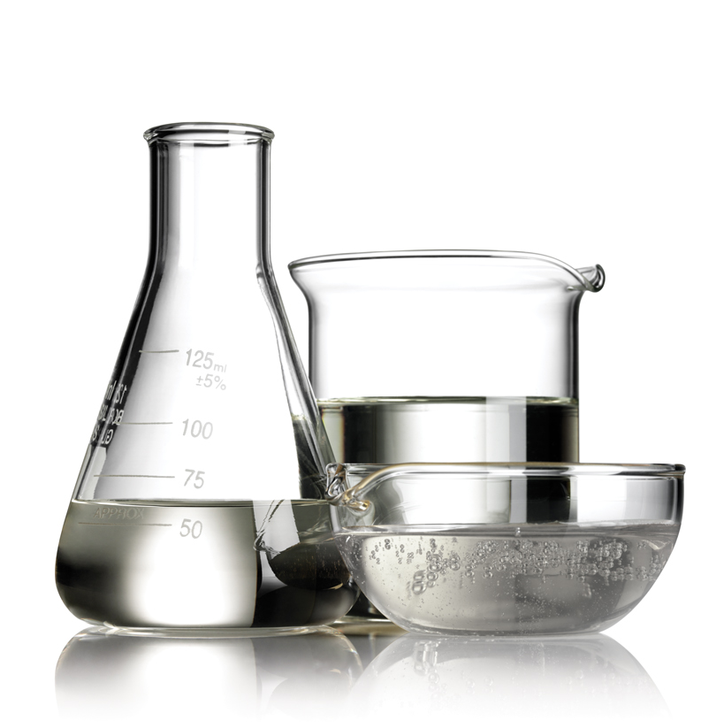
Ageloc me™ formulations
In 2014, we:
made over 700 laboratory batches
worked on 170 different formulas
created up to 50 different iterations
per formula
sent 279 batches/formulas through Microbiological Challenge Test Protocol
tested over 11,000 micro plates
tested over 370 batches for stability
Notes:
We recently completed the most ambitious product development project in Nu Skin history.
In our 2014 development of ageLOC Me, we
made over 700 laboratory batches
worked on 170 different formulas
created up to 50 different iterations per formula
sent 279 batches/formulas through Microbiological Challenge Test Protocol
tested over 11,000 micro plates
tested over 370 batches for stability

Slide 19


