Slide 1

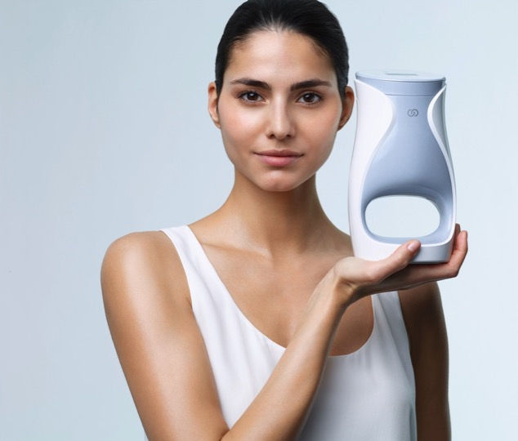
讓我們來談談
Notes:
Let’s talk about me. Not ME, but ageLOC Me. Because it’s so personal and individual that it’s really about you, and me, and all of us.
讓我們來談談me，不是「我」，而是ageLOC Me。因為它是非常個人化、獨特的設計，所以真的是關於你、我，還有我們所有人的。

Slide 2
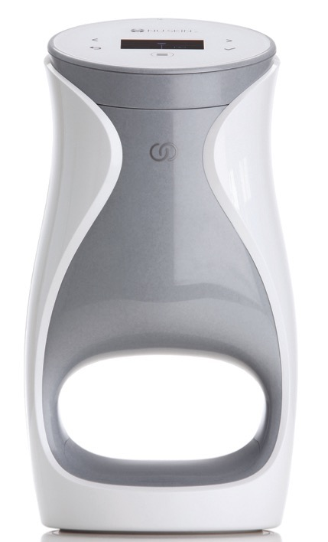
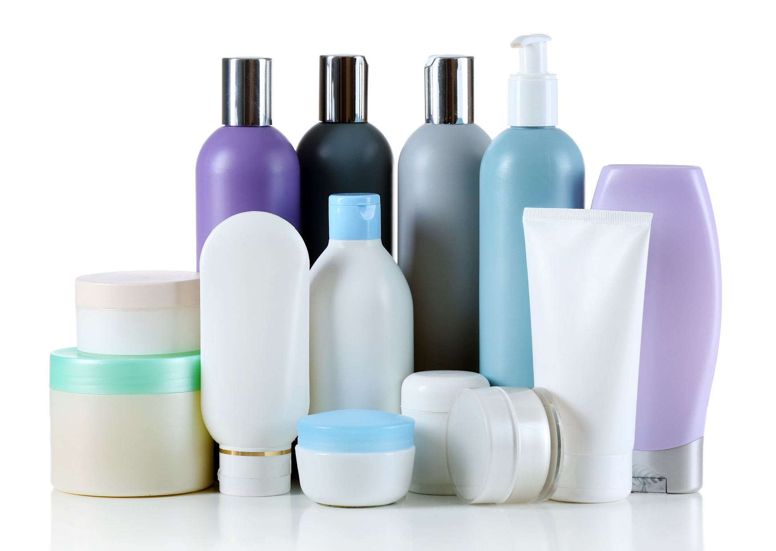
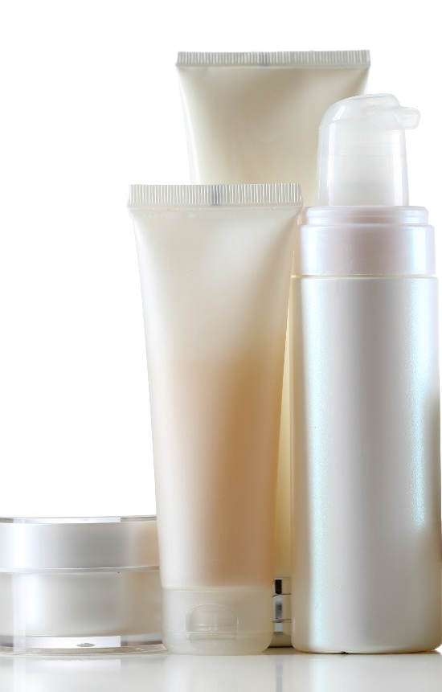
讓我們來談談 me
方便且簡單
Notes:
There are millions of products in the global beauty industry. Some people are really good at curating their own regimens and know what they want. Others, however, are intimidated by skin care and may be confused by all the options that are available. They may not know what’s right for them. That’s what is so great about ageLOC Me. Even if you’re a skin care novice, you can easily find a regimen that will deliver the best results for your skin.
With ageLOC Me, you don’t need to crowd your vanity or bathroom cabinet with dozens of bottles, tubes, and jars. ageLOC Me is simple, convenient, and easy to use.
在全球美容產業中有上百萬種產品。有些人非常擅長創造自己的護膚方案，也知道他們想要的成果。然而其他人對護膚感到不知所措，也對所有的選擇感到困惑。他們不知道什麼才適合自己。那也是ageLOC Me很棒的原因之一。即使對護膚方面只是初學者，您也能輕易找到為自己肌膚帶來最佳效果的護膚方案。
擁有ageLOC ME，您不需要在梳妝台或浴室櫃子裡堆滿瓶瓶罐罐。ageLOC Me在使用上非常簡單與方便。

Slide 3
讓我們來談談 me
let’s talk about m
肌膚護理的新世代
30年抗老基因科學
主攻老化根源
色素沈澱過度及老年斑
含SPF，或不含SPF
含香味，或不含香味
更柔軟、質地更細緻

Slide 4
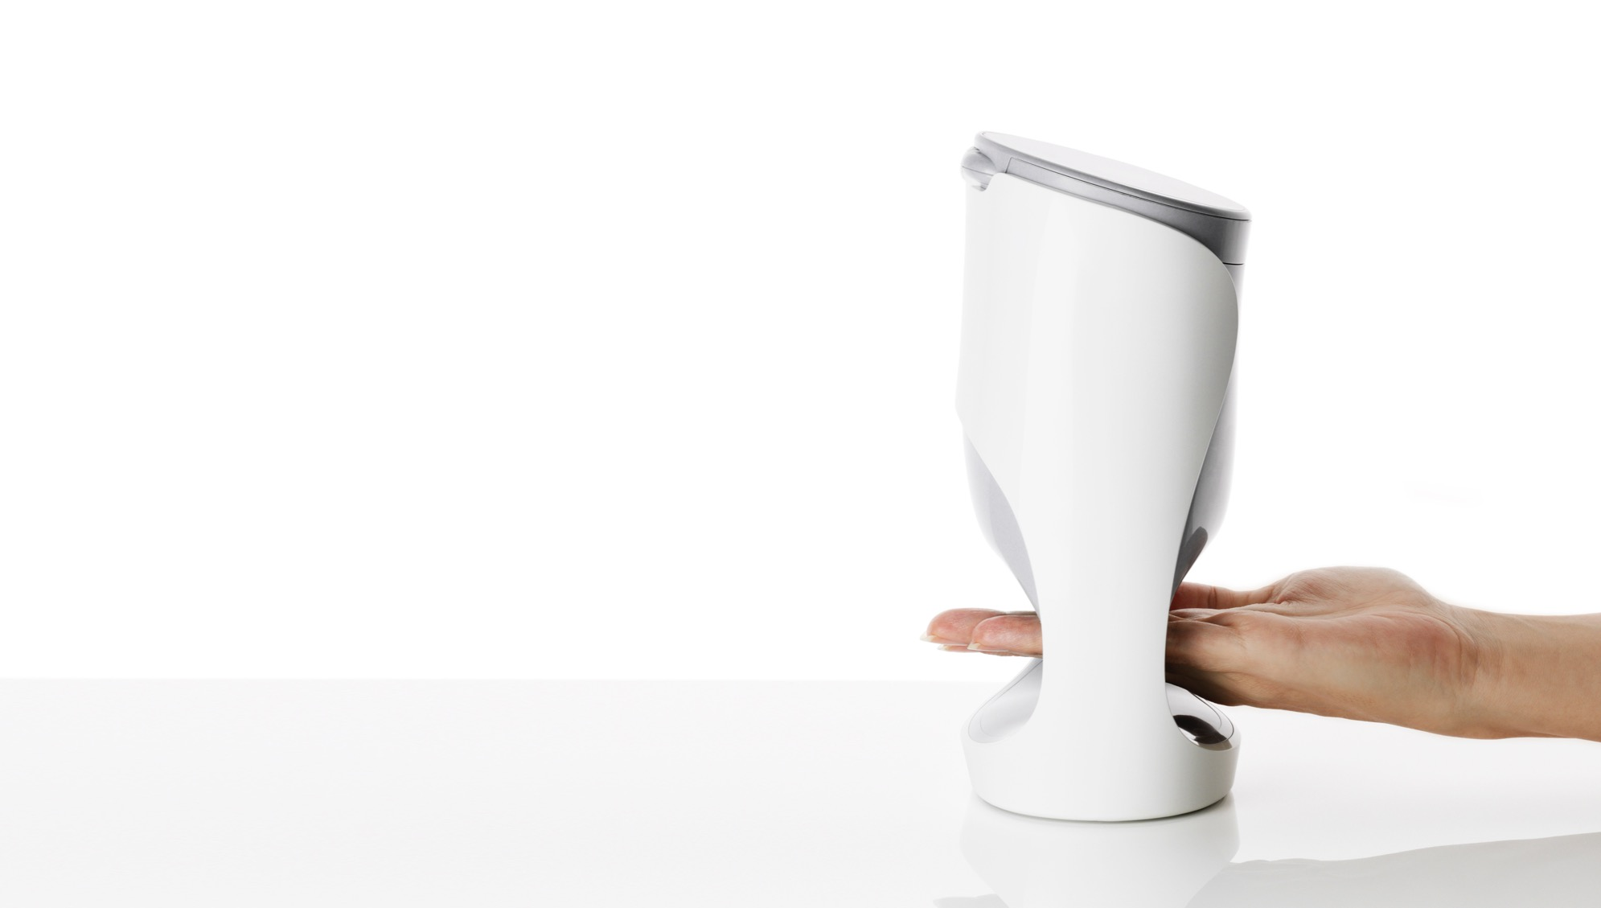
增加皮膚光澤
協助縮小毛孔
改善外表的細紋和皺紋
修飾輪廓和緊致肌膚
保濕和強化
平靜、舒緩、修復
適合不同的肌膚類型

Slide 5
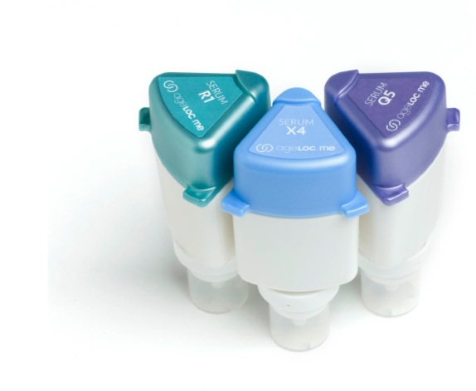
AGELOC ME™ 精華液
協助細胞更新
減少色素沈澱
針對細紋、皺紋及緊致度
Notes:
Cellular Turnover
Specialized ageLOC Me Serum helps improve cellular turnover to refine texture, reduce the appearance of pores, and reveal smoother, softer skin—for a noticeably younger looking you.
Pigmentation
Specialized ageLOC Me Serum helps prevent the visible signs of hyperpigmentation and age spots to reveal more even, radiant skin—for a noticeably younger looking you.
Lines/Wrinkles, Firmness
Specialized ageLOC Me Serum helps improve the visible signs of lines, wrinkles, and sagging—for a noticeably younger looking you.
細胞反轉
特製的ageLOC Me精華液，協助改善細胞反轉，來提升質感、縮小毛孔，展現更光滑、柔軟的肌膚－讓您明顯地更加年輕。
色素沈澱
特製的ageLOC ME精華液協助預防顯著的色素沈澱、和老年斑，來展現更均勻、更有光澤的肌膚－讓您明顯地更加年輕。
細紋、皺紋、緊致度
特製的ageLOC ME精華液協助改善明顯的細紋、皺紋、和下垂肌膚表徵－讓您明顯地更加年輕。

Slide 6
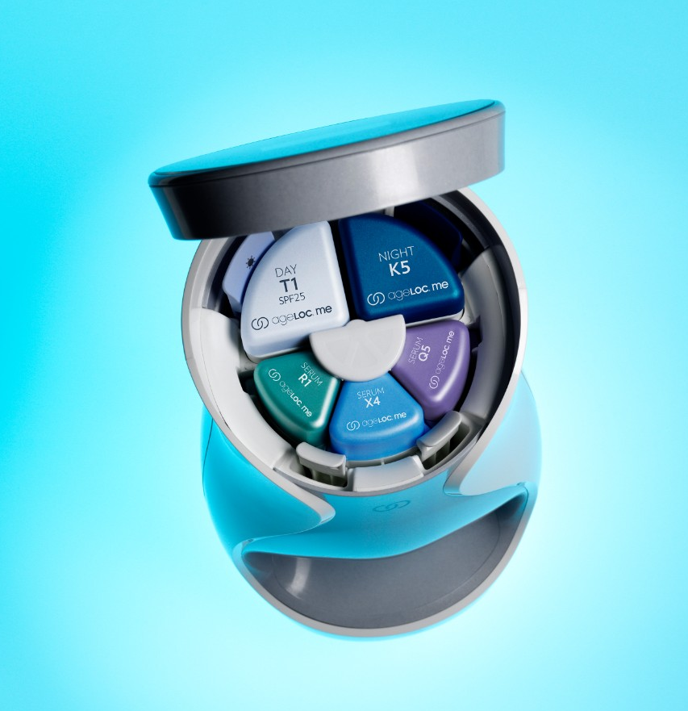
超級精華液
更高濃度的活性成分
結合以提供無法在單一產品中調配的關鍵成分之更高劑量和成效。
Notes:
Designed with customization in mind, we have separated the “treatment” products into three separate serums. This novel approach allows for three targeted serums with ingredients focused on particular skin concerns that combine prior to use. So not only does it allow for customization, but it enables a larger array of key ingredients at potentially higher concentrations than what we could easily formulate into a single product. This results in a better product for you.
設計時考慮到客製化，我們將「治療」產品分開放進三種單獨的精華液中。這種新穎的方法，允許三種含有鎖定特定解決肌膚疑慮之成分的主攻精華液，在使用當下做結合。所以不只允許客製化，甚至比起普遍可以調配進單一產品的劑量，我們能擁有更高濃度、更廣泛的關鍵成分。

Slide 7
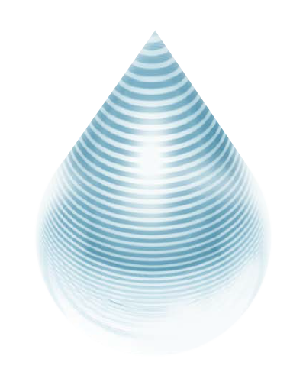
革命性的
微層技術
ageLOC Me™裝置將定製的精華液交織為40層，均勻地分發關鍵成分、優化精華液組合，增加肌膚的吸收率。
Notes:
Some people say it looks great, and it sounds great, but what’s really happening inside the device? How can you deliver better ingredients in a more efficacious way than we historically have? The answer is our proprietary microlayering technology. The ageLOC Me device weaves the customized serums together into 40 layers and delivers them at the moment of use, evenly distributing the key ingredients, optimizing the serum combination, and resulting in increased absorption of anti-aging formulations into the skin.
有些人說它看起來不錯，且聽起來很棒，但裝置裡到底發生什麼事？如何比過往更有效地傳遞更好的成分？答案是我們專有的微層技術。ageLOC Me裝置在傳遞使用當下，將定製的精華液交織成40層，均勻地分發關鍵成分、優化精華液組合、增加肌膚對抗老配方的吸收率。

Slide 8
結果：使肌膚能多三倍的滲透及吸收力，且有更多活性物質均勻地分佈進肌膚裡－來獲得更好的結果
AGELOC ME裝置的AGELOC ME微層技術™
精華液
R
X
此圖為皮膚的橫剖面圖（角質層）
3x
Q
*使用ageLOC Me裝置混合三種精華液（ageLOC Me微層技術），比起手動混合，可更有效改善肌膚的吸收力。
*以角質層來比較「肌膚吸收力」
* 三倍是通過以裝置混合（微層技術）與手動混合的平均數據點來計算。
角質層
此圖表顯示不同的精華液，在使用微層技術時可以均勻分配，因此三種精華皆保持活躍性能。
沒有AGELOC ME裝置，使用手動混合
R
精華液
X
此圖為皮膚的橫剖面圖（角質層）
Q
角質層
此圖表顯示精華液無法被均勻分配，因為是手動混合．
Notes:
Nu Skin (2015). [In-Vitro Data Illustrating the Differences in Skin Absorption Based on Combination Methods of ageLOC Me Serums]. Unpublished raw data.
During our development we were concerned that combining the three serums inadequately would allow for hot spots or missed areas on the skin. We have identified that through the ageLOC Me device the serums are evenly dispersed. This ensures that all three serums are adequately spread throughout the combination prior to application on the skin, therefore when applied each serum will reach and is equally represented in all areas of the application site—your face.
Additionally, we commissioned a third party testing house to measure the differences in absorption of a key ingredient when the serums are combined via the ageLOC Me device versus when the device was not used. Amazingly, the ageLOC Me Device combination resulted in three times better absorption into the stratum corneum than the non-ageLOC Me serum combination. This shows another benefit of the ageLOC Me Device; it is undoubtedly a key part of the ageLOC Me System.
Nu Skin（2015）。[試管內的資料，在ageLOC Me精華的結合方式中說明不同膚質的吸收量（In-Vitro Data Illustrating the Differences in Skin Absorption Based on Combination Methods of ageLOC Me Serums）]。未發表的原始資料。
在開發時，我們擔心不適當的結合三種精華液，可能會導致潛在的危險，或是落下某個肌膚區域。研究顯示若透過ageLOC Me裝置，這些精華液就能均勻分配。這確保三種精液華，都能適當地在塗抹於肌膚的當下均勻混合。因此當您在塗抹時，所有的精華液都能在您的臉上各個區域塗抹均勻。
此外，我們委託第三方測試機構來測量關鍵成分的吸收度，測試分為以ageLOC Me裝置結合、和沒有使用裝置結合的精華液。令人驚訝的是，使用ageLOC Me裝置結合的精華液，比起沒有使用裝置的精華液，高了三倍的吸收率。這顯示另一個使用ageLOC Me裝置的優勢，也無庸置疑的是ageLOC Me系統中一個關鍵部分。

Slide 9
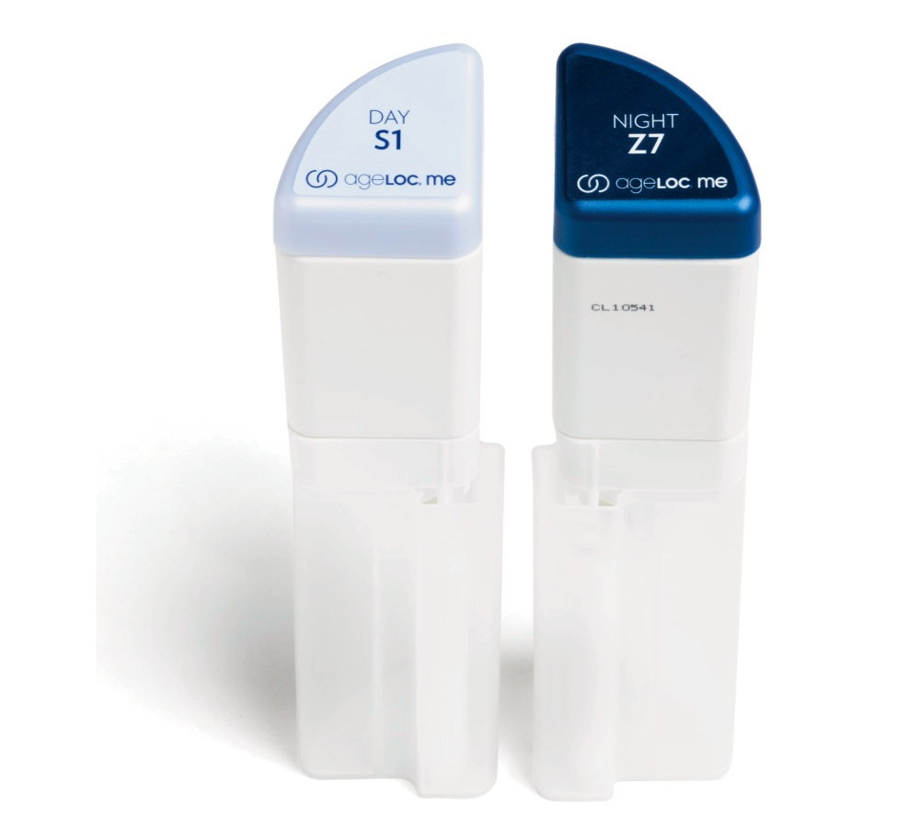
AGELOC ME™保濕液的優點
保濕屏障
平靜、舒緩、修復
以肌膚類型定製
以肌膚質地定製
以香味定製
以SPF定製
Notes:
Provide hydration to strengthen and maintain the skin’s natural moisture barrier
Day Moisturizer provides optional broad spectrum protection from UVA and UVB radiation with SPF 20/25
Night Moisturizer calms, soothes, and rejuvenates skin during its natural nighttime recovery process
Formula combinations are suitable for different skin types, including dry, normal, combination, and oily skin.
Offer different options for texture and overall feel based on climate, skin type, and personal preference
Customizable elements include fragrance/non-fragrance and SPF/non-SPF
提供水分，來強化和維持肌膚天然的保濕屏障。
日間保濕乳提供選擇性UVA和UVB輻射的廣譜保護，有SPF20／25
夜間保濕乳在肌膚天然夜間恢復過程中，鎮靜、舒緩、和修復肌膚
配方結合適合不同的肌膚類型，包含乾性、中性、混合性、及油性肌膚。
為不同質地和整體感受，如氣候、肌膚類型、和個人喜好等而有不同選擇
可定製的成分包括含香味／無香味，有SPF／無SPF

Slide 10
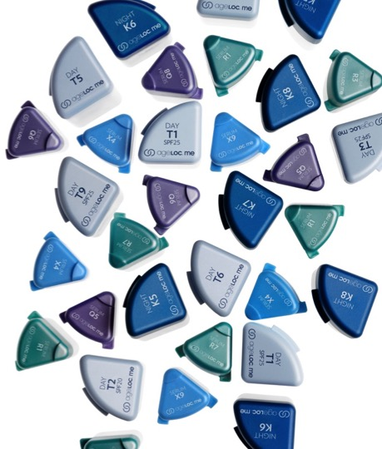
let’s talk about me
讓我們來談談me
核心組合比對完整組合
Notes:
ageLOC Me Core Customization Sets cost $99.00, and focus on skin type (dry, normal/combination, oily), options for fragrance or fragrance free, and your choice of SPF or SPF-free. ageLOC Me Full Customization Sets cost $149.00, and focus on the items listed above as well as: climate, sun and chemical exposure, skin texture, level of moisturization, ethnicity, skin sensitivity, skin discoloration, lines and wrinkles, and radiance.
The ageLOC Me Reference Set sits right in the middle of the spectrum from super oily skin to super dry skin as well as in the middle of targeting signs of aging. The Reference Set is designed for normal skin types with gentle focus on anti-aging, to allow the widest range of people to use it without irritations. The Reference Set is also priced at $99.00.
ageLOC Me Core & Full Customization Sets contain ageLOC ingredients similar to ingredients in ageLOC Transformation. The ingredients in ageLOC Me Core and Full Sets target the same sources of aging as ageLOC Transformation (the 8 ways) there is just newer technology involved. ageLOC Me Core Customization Sets will be more like ageLOC Transformation than Nutricentials. Both the Core Sets and Transformation sit closer to the middle spectrum trying to target the widest ranges of skin possible. ageLOC Me Full Customization Sets get much more specific and targeted. If you noticed from the first paragraph ageLOC Me Core targets about 3 main things (pretty general) while ageLOC Me Full targets about 12, which reflects the price differences.
ageLOC Me核心客製組價格為$99.00，專注於不同的肌膚類型（乾性、中性／混合性、油性），有含香味、或無香味選項，含SPF或無SPF。ageLOC Me完整客製組價格為$149.00，專注於以上所提及事項，還有：氣候、太陽和化學暴露、肌膚質感、保濕程度、種族、肌膚敏感性、肌膚色斑、紋路和皺紋、以及肌膚光澤。
The ageLOC Me參考組，座落在超級油性肌膚、和超級乾性肌膚中間，以及在主攻老化象徵上也處於中間值。參考組是設計給中性肌膚類型，溫和鎖定抗老，允許較廣泛的人們使用而不刺激皮膚。參考組價格也是$99.00。
ageLOC Me核心及完整客製組，包含的ageLOC成分與在ageLOC Transformation裡的成分類似。在ageLOC Me核心及完整組中的成分，與ageLOC Transformation主攻同樣的老化根源（8種方法），只是涉及較新的科技。比起Nutricentials，ageLOC Me核心客製組和ageLOC Transformation比較相似。核心組和Transformation都較偏向中間值，試著針對最廣泛的肌膚類型。
ageLOC ME完整客製組比較有特定性和主攻性。若您有注意到在第一段，ageLOC Me核心組有三項主要鎖定的特點（很普遍）；而ageLOC ME完整組則鎖定12項，這也反映在價差上。

Slide 11
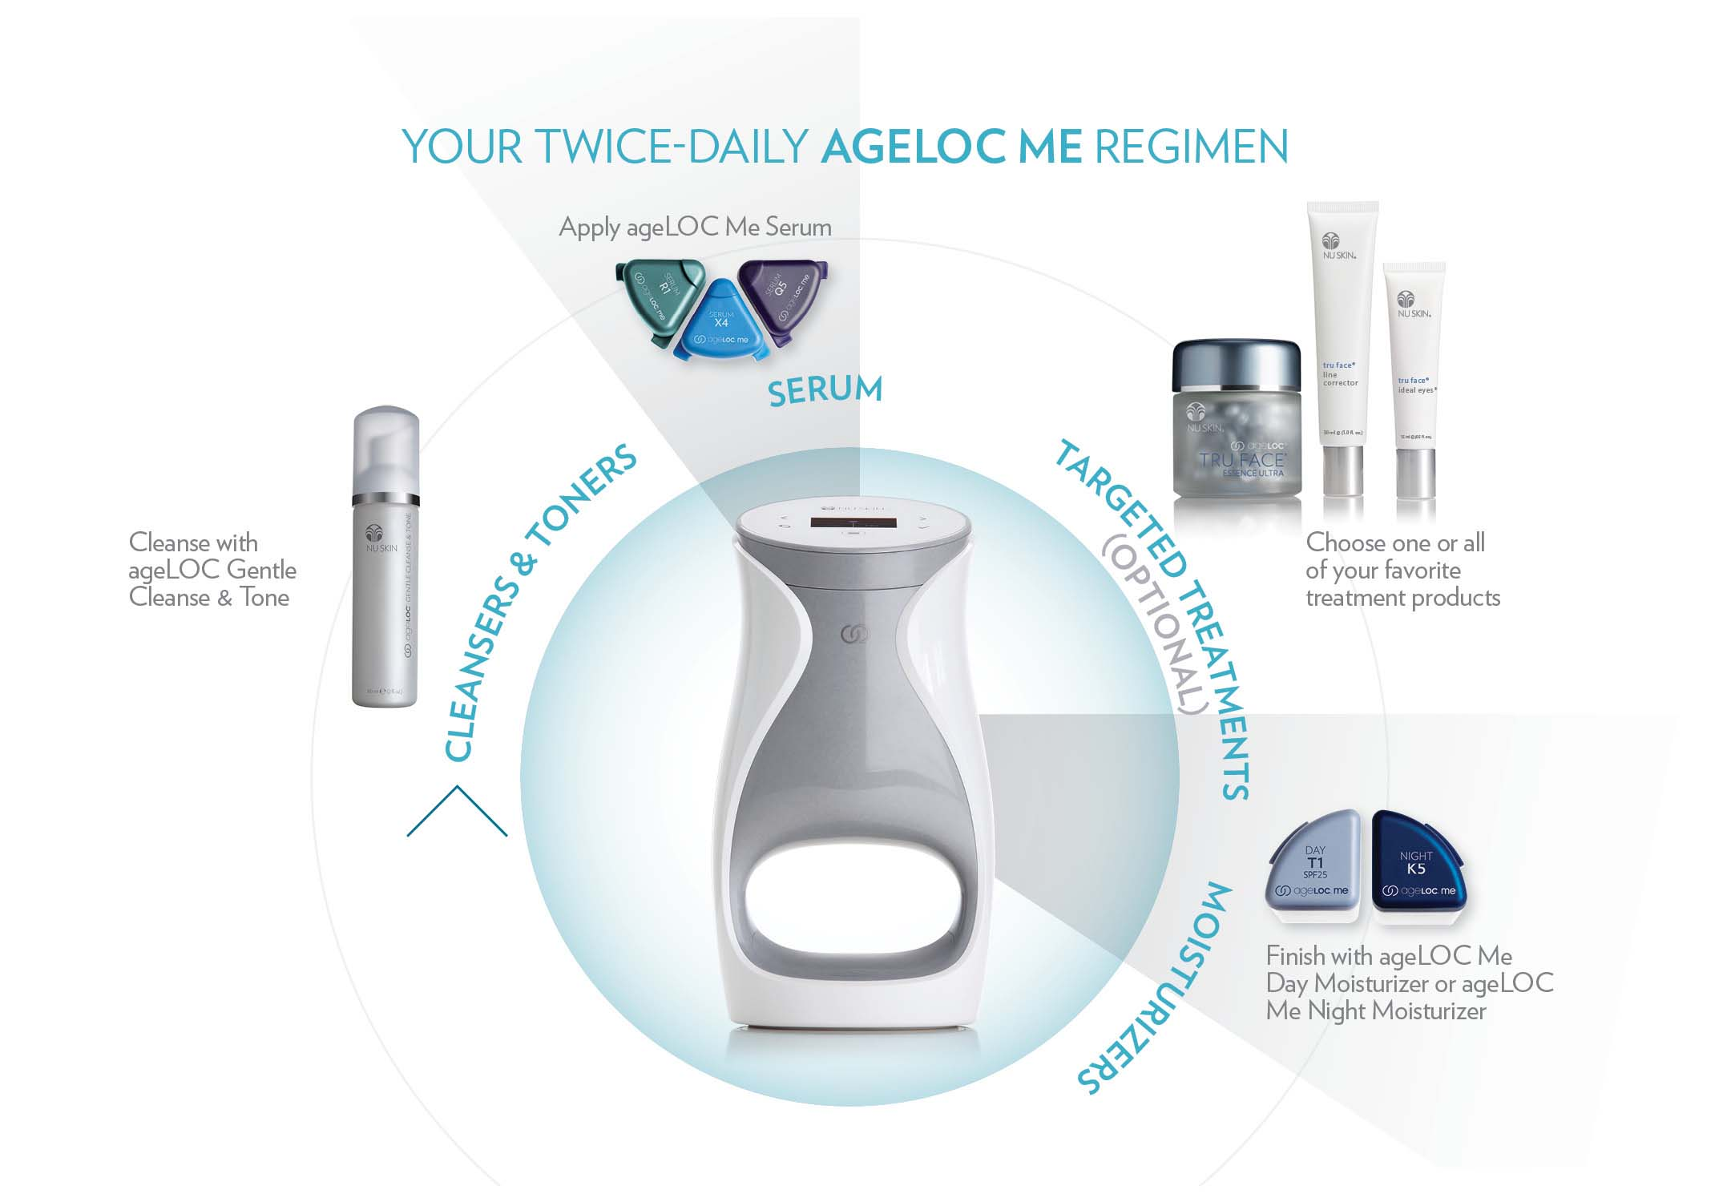
Notes:
And of course all the other Nu Skin products you know and love can fit easily into your ageLOC Me regimen.
當然，您所知道、和喜愛的所有其他Nu Skin產品，可以很容易地納入您的ageLOC Me方案中。

Slide 12
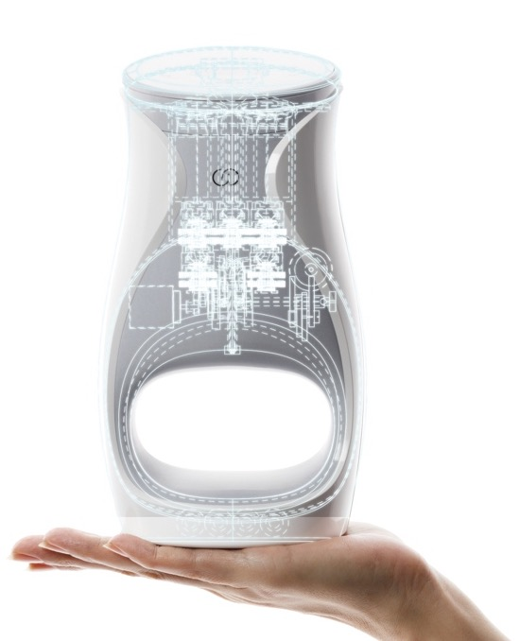
您個人的肌膚護理實驗室
let’s talk about me
世界級的工程
27項ageLOC專利與專利申請，
其中 5 項特別針對ageLOC Me
Notes:
We protect our intellectual property. ageLOC Me employs world-class engineering and is exclusive to Nu Skin—and only YOU have the ability to share it with the world. Our proprietary ageLOC science boasts 27 patents or patents pending. This means no other company on the planet can offer this level of innovation.
And in case you’re wondering, 5 of the 27 patents cover ageLOC Me’s mechanisms for delivering customized skin care to you.
我們保護我們的智慧財產。ageLOC Me使用Nu Skin專有的世界級工程－而且只有「您」有能力與世界分享。我們獨有的ageLOC科技，帶來27項專利、和專利申請。這代表世界上沒有其他公司能提供同樣等級的創新產品。
順道一提，27項專利中有5項含括了ageLOC Me使用來為您傳送客製化肌膚護理的機制。

Slide 13
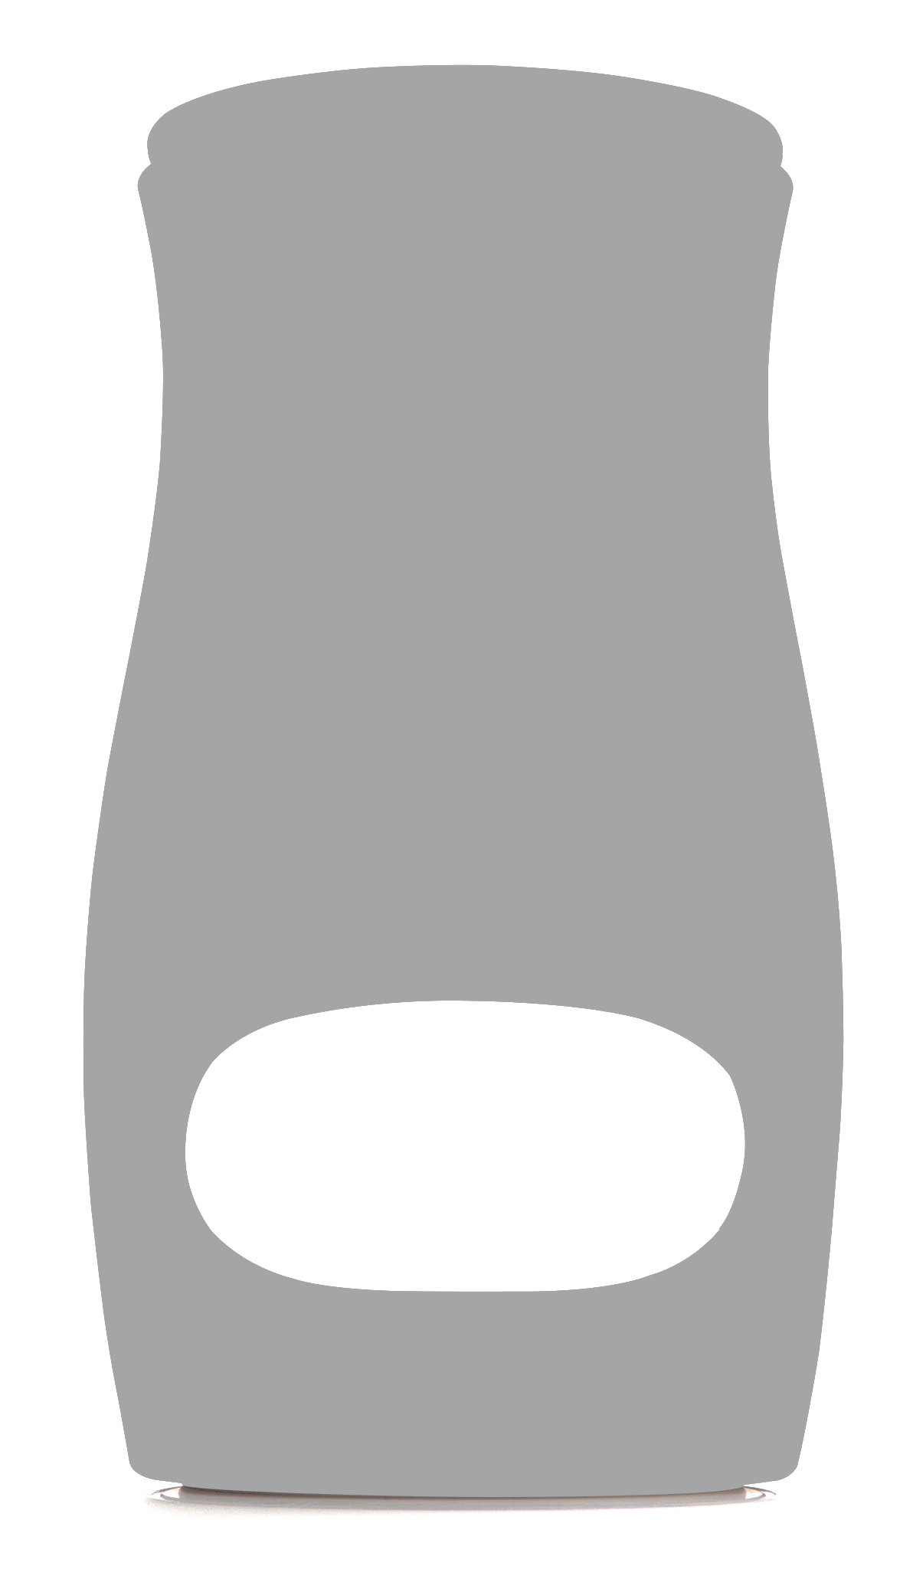
您個人的肌膚護理實驗室
已投資
$3,500萬
Notes:
We decided to change the landscape of the skin care industry and we invested our time, passion, and financial resources to bring ageLOC Me to you and your customers. ageLOC Me represents the most ambitious product development endeavor in Nu Skin’s history.
After several years of intensive research and development and a more than $35-million investment, we have invented a skin care system with product formulations customized to you.
我們決定要改變護膚產業的樣貌，因此我們投入時間、熱誠，以及金融資源，將ageLOC Me帶給您與您的顧客。ageLOC Me代表了Nu Skin歷史上所做過最具雄心的產品發展。
在經過幾年密集的研究與發展，以及超過3500萬的投資之後，我們發明了專門為您量身定製的產品配方之肌膚護理系統。

Slide 14
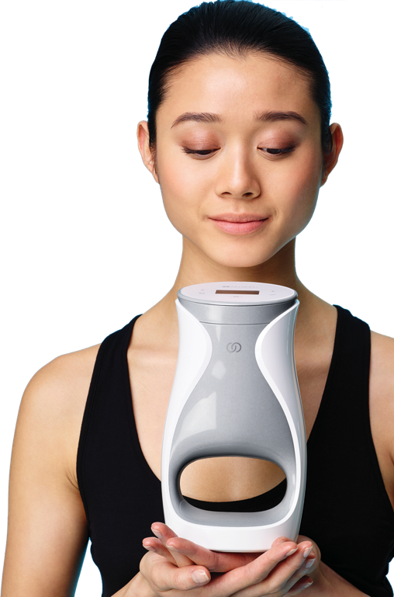




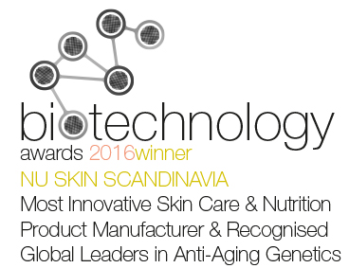


您個人的肌膚護理實驗室
WORLD-CLASS DESIGN
Notes:
Nothing like ageLOC Me has ever been done before and it is truly a breakthrough in the beauty industry. So far, we’ve received these awards for our design and innovation.
ageLOC Me是前所未有的，而且在美容產業確實是一大突破。到目前為止，我們已為此設計及創新獲得這些獎項。

Slide 15
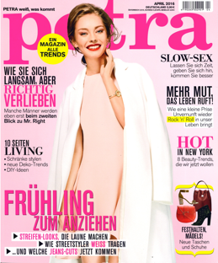
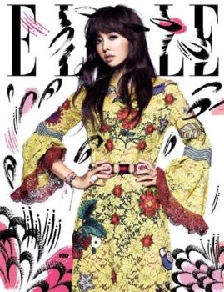
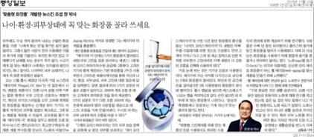
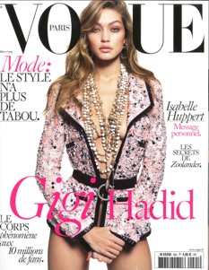

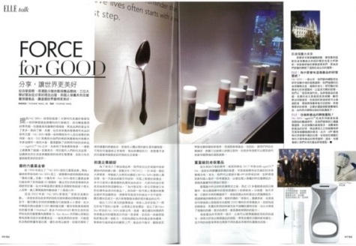
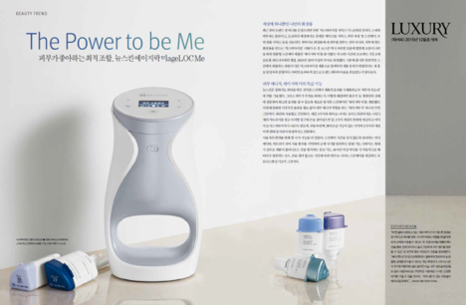
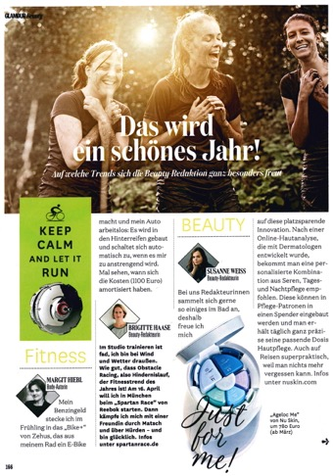
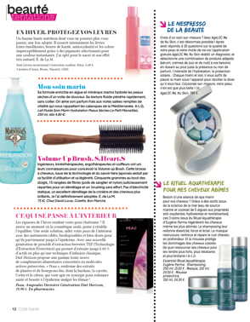
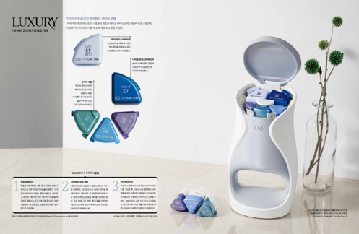
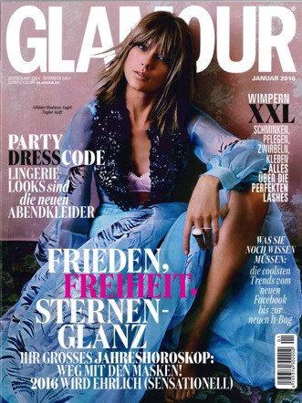
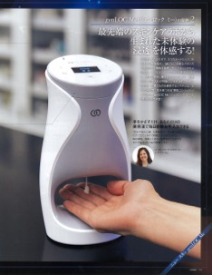
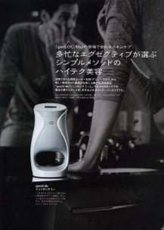
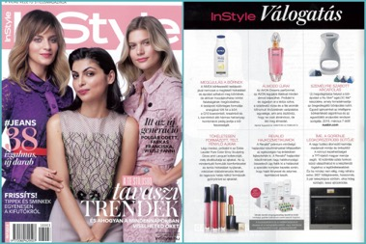


Slide 16
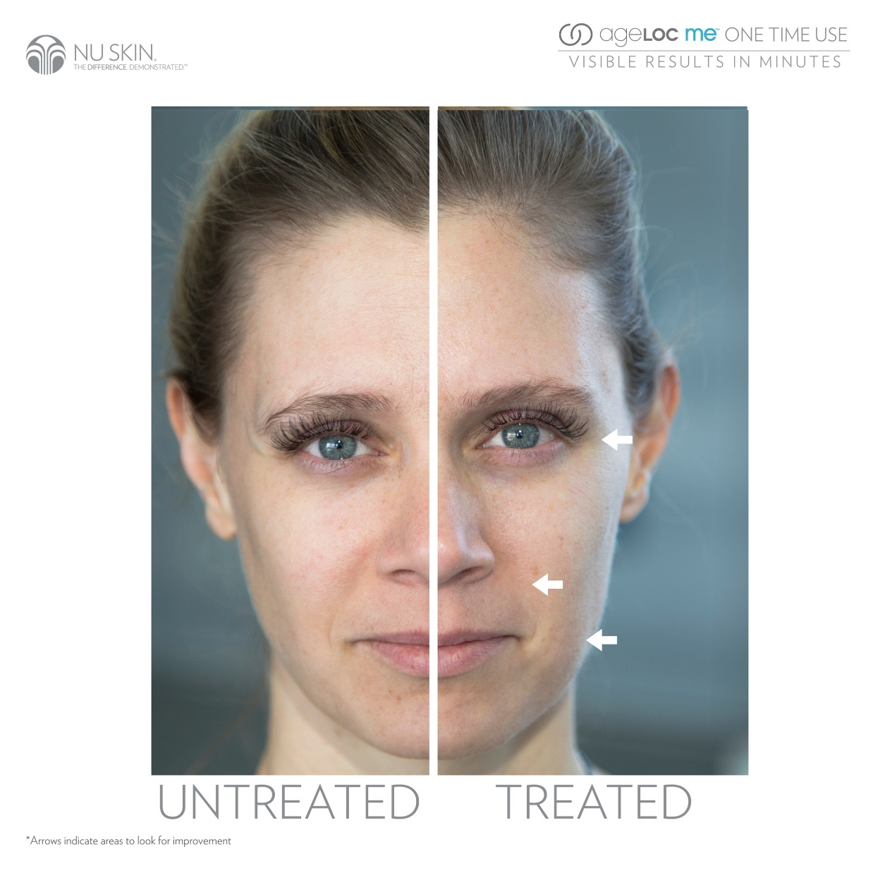

Slide 17
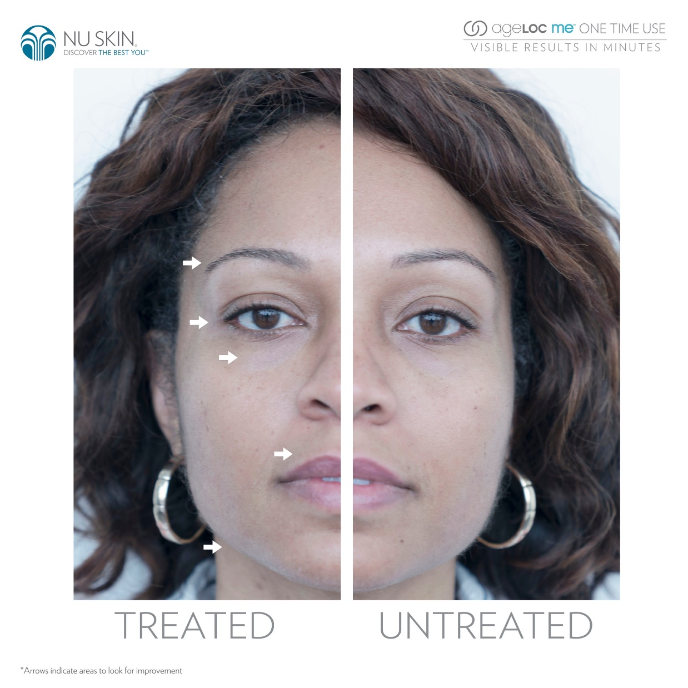

Slide 18
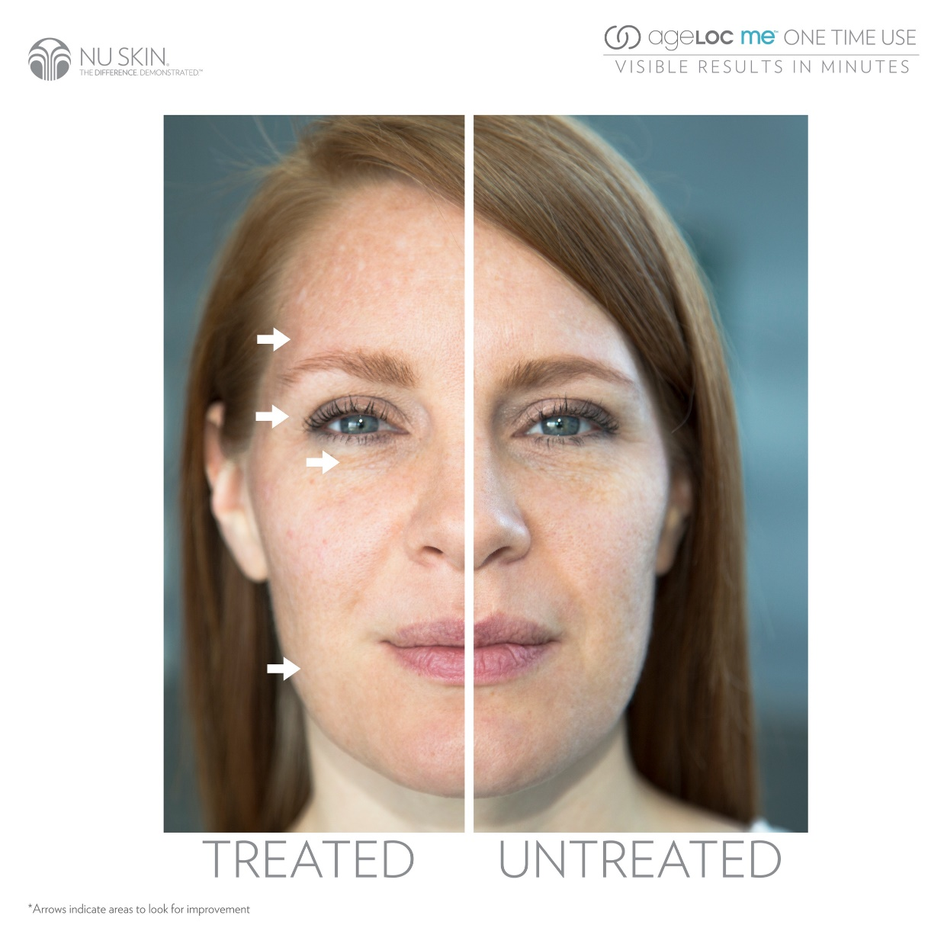

Slide 19
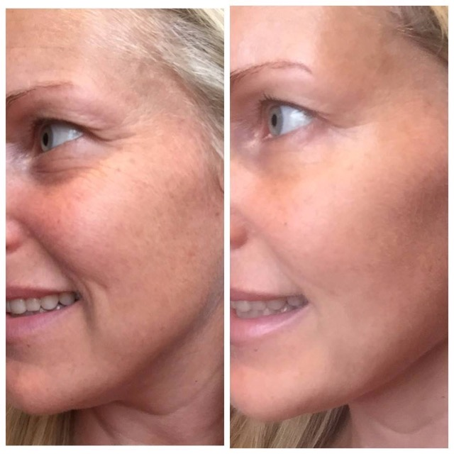

Slide 20
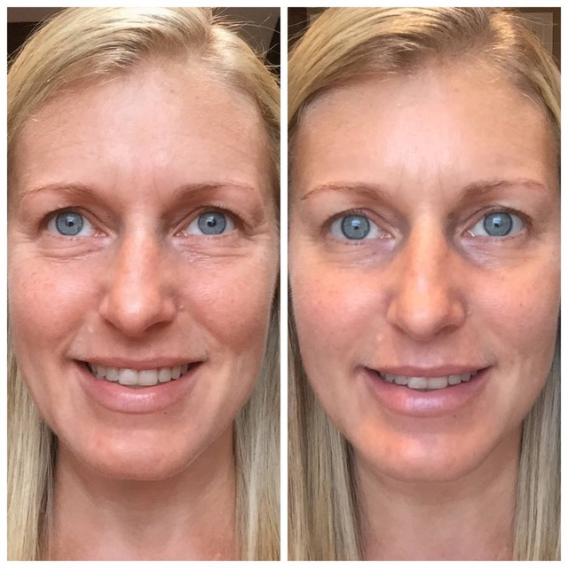

Slide 21

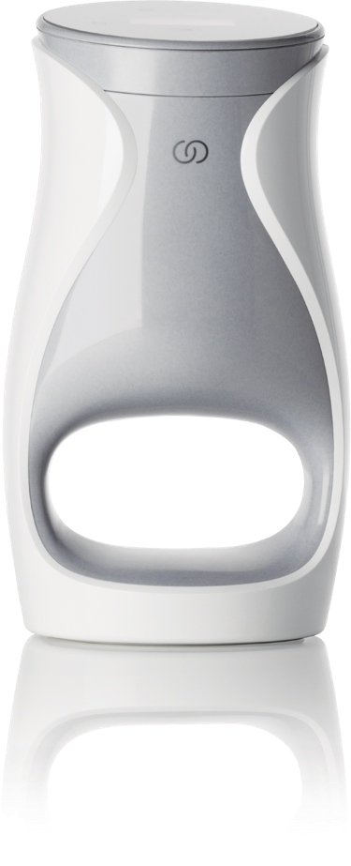
未來在這裡…您準備好了嗎？

